Slide 1
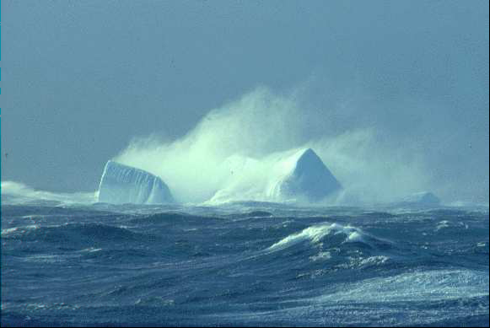
The Southern Ocean

Slide 2
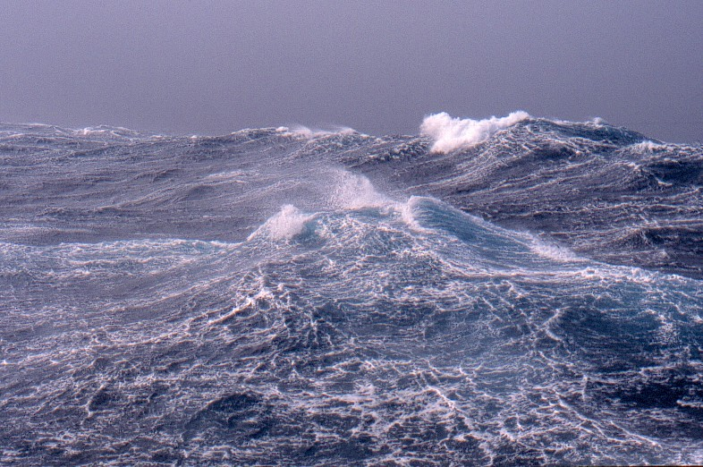
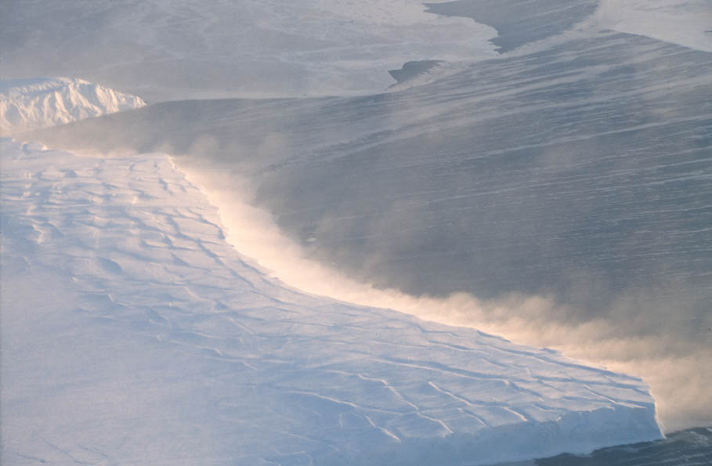
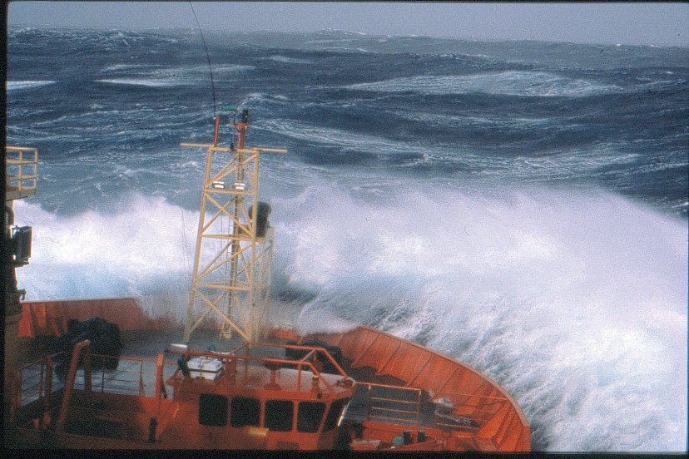

Slide 3
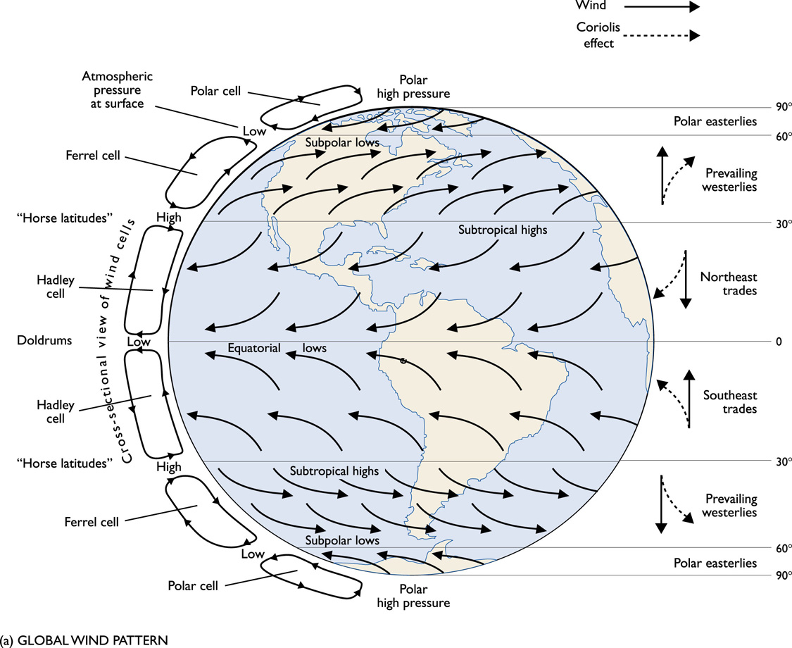

Slide 4
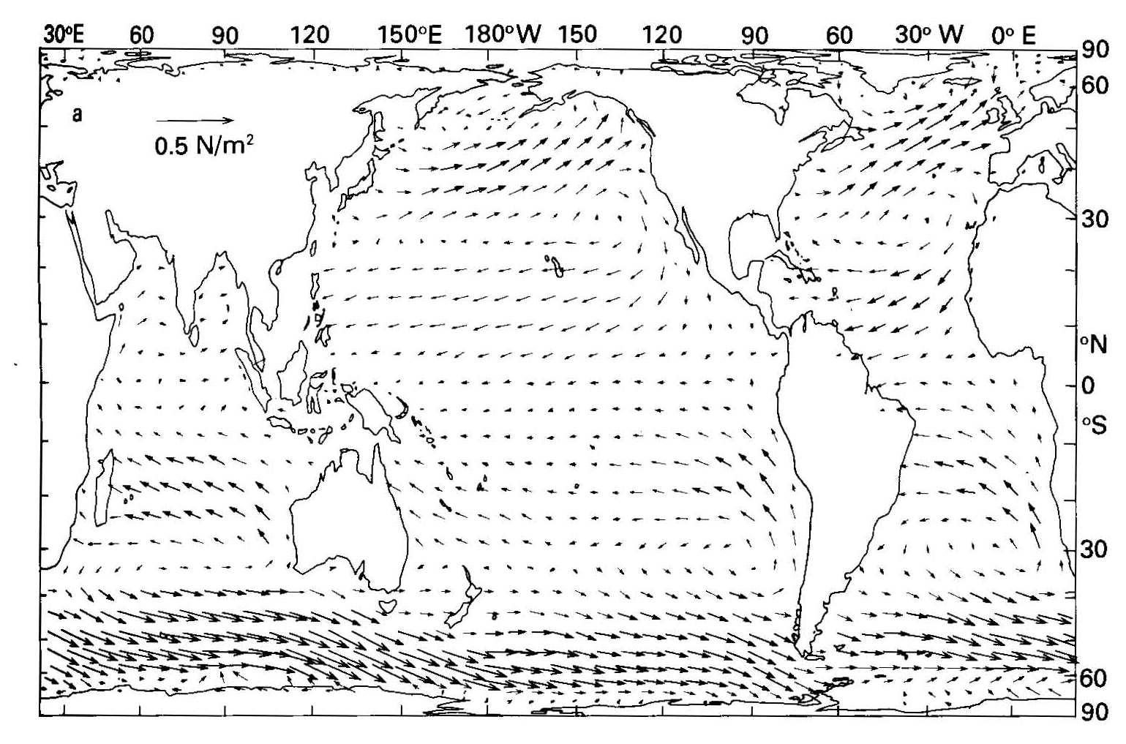
Annual mean wind stress
Southern Ocean westerlies are strong. (Fig. from Tomczak and Godfrey)

Slide 5
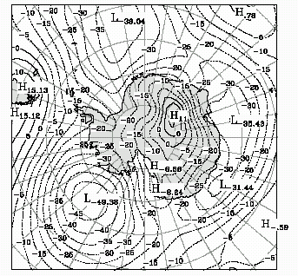
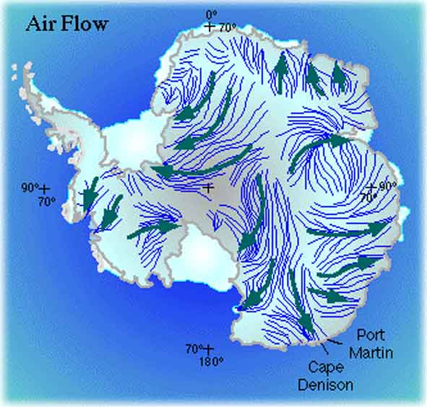
POLAR CELL
Mean position is between 60°N/S and the North/South Pole.
At the pole, cold, dense air descends, causing an area of subsidence and high pressure.
As the air sinks, it begins spreading outwards from the pole.
Since the coriolis effect is strongest at the poles, the outward moving air deflects sharply. This wind regime is called the surface polar easterlies.

Slide 6
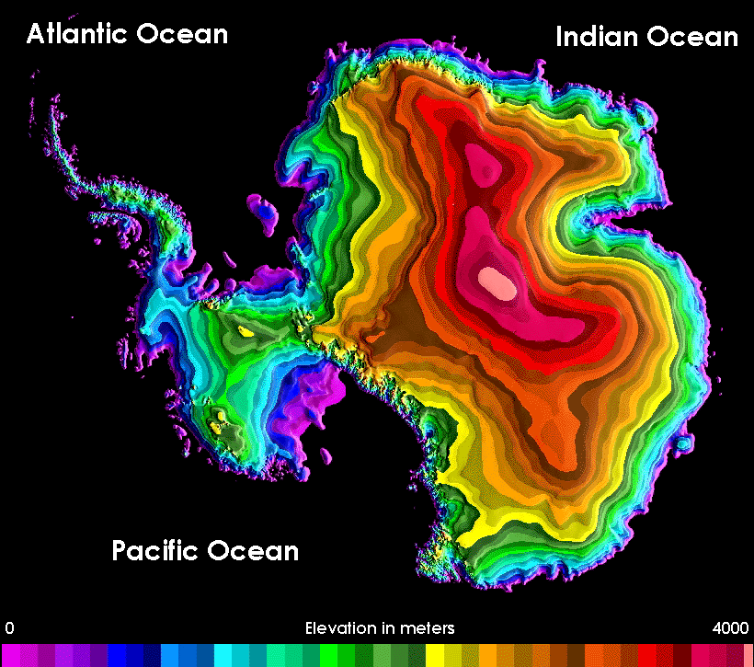
The Wind Regime of the Southern Ocean
A stationary high pressure cell lies over the Antarctic Plateau ~83ºS.
Strong katabatic winds descend from the Plateau to the coast and are deflected to the west by the Coriolis force, forming the POLAR EASTERLY wind belt. ANTARCTICA IS HIGH!!

Slide 7
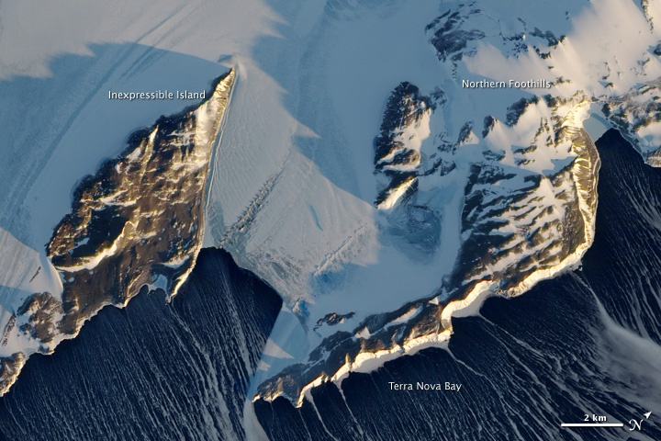

Slide 8
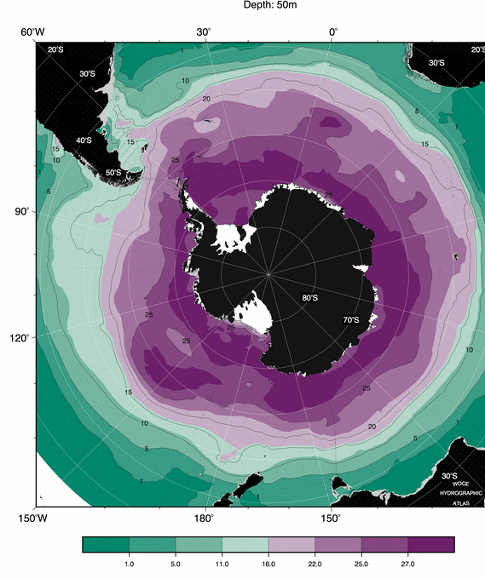
Evidence of upwelling: Near-surface nitrate
High values reflect upwelling.
Driven by Ekman suction.
http://woceatlas.tamu.edu
(Orsi and Whitworth, 2005)

Slide 9
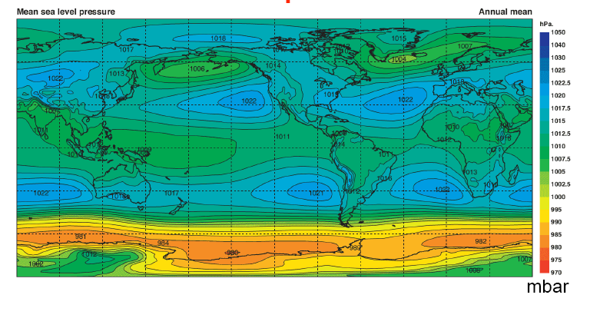
Between 60º and 73º S lies a low pressure belt known as the ANTARCTIC TROUGH. This trough is formed from cyclones generated at the atmospheric polar front. In this narrow band a westward flowing coastal current is formed known as the EAST WIND DRIFT. This current flows along the coast as a narrow coastal jet.
North of the ANTARCTIC TROUGH between 35º and 60º S lies a belt of subtropical high pressure cells. The circumpolar belt of westerly winds is dominated by frequent winds and high waves, which die south of 65ºS.

Slide 10
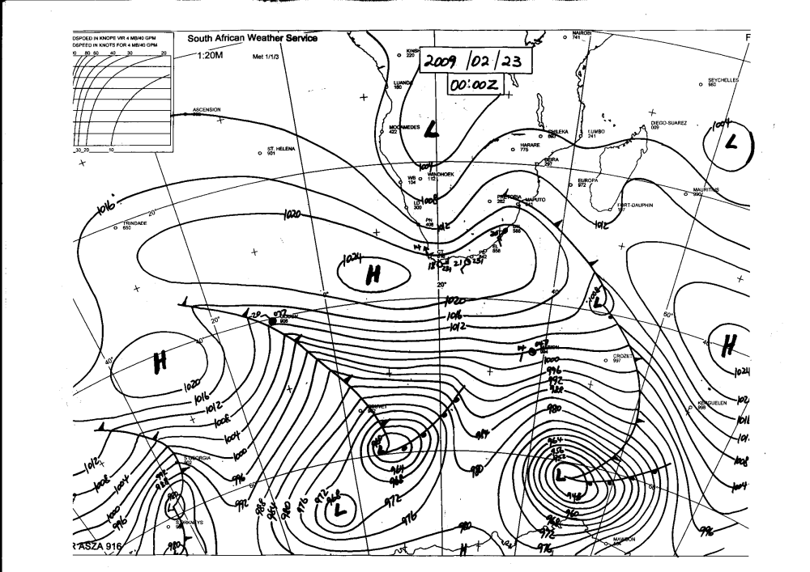

Slide 11
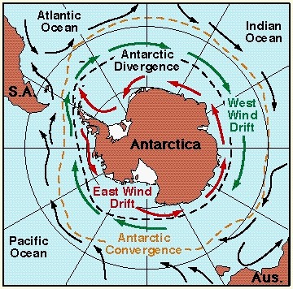
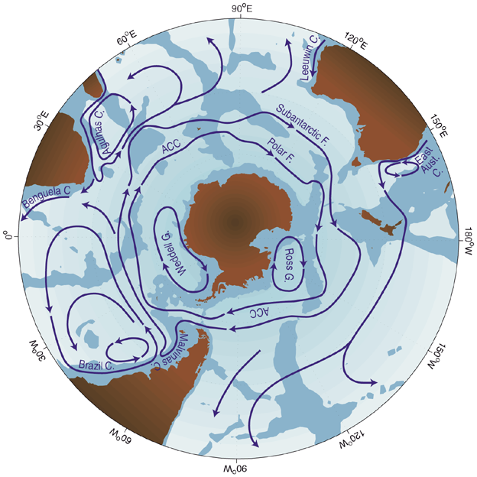
The Southern Ocean :
an annular ocean that connects the world ocean basins
The inter-basin connection
provided by the ACC
permits a global overturning circulation.
Thus enables the global transport of heat and fresh water which in turn influence climate

Slide 12
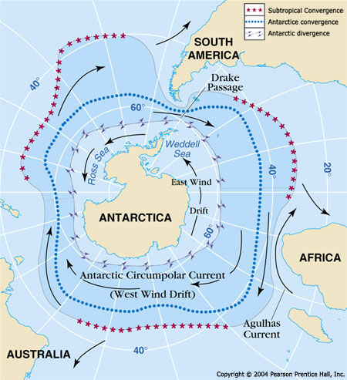
Antarctic divergence
Here water is upwelled
to the surface ..
another upwelling
System in the open
ocean!

Slide 13
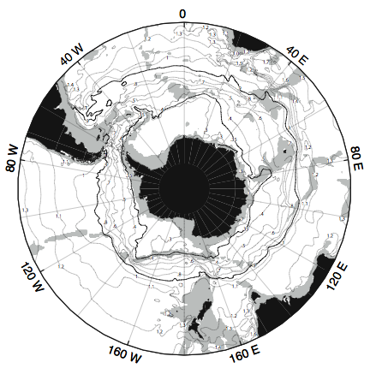
Antarctic Circumpolar Current
No meridional boundary at Drake Passage latitudes
Different dynamics from normal gyres (which have western and eastern boundaries)
Wind stress causes current that extends to bottom, flows eastward
Shear from 50 cm/sec at surface to about 5-10 cm/sec at bottom

Slide 14
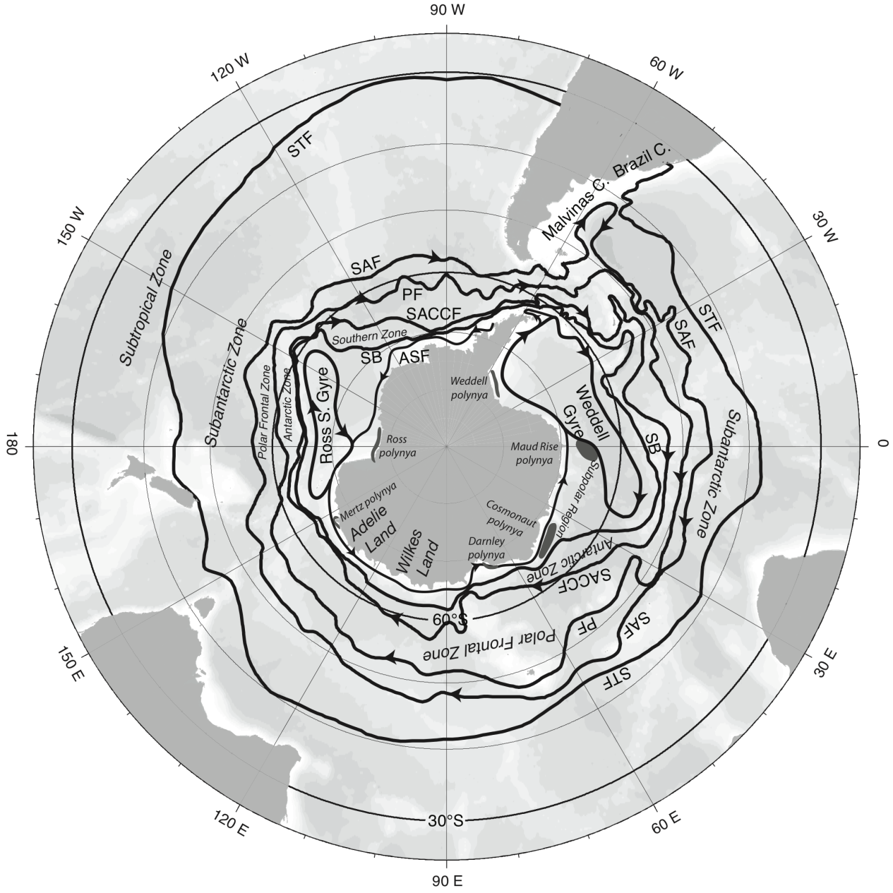
Antarctic Circumpolar Current: banded (jet-like) structure
Fronts of the Antarctic Circumpolar Current
Subantarctic Front on north side
Polar Front in middle
Southern ACC Front to south
Southern Boundary or continental shelf front
Antarctic Slope Front (westward flow along continental slope)

Slide 15
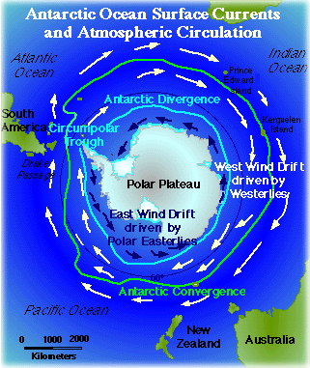
The Southern Ocean is dominated by the Antarctic Circumpolar Current – BUT a coastal current exists called the EAST WIND DRIFT – formed by the katabatic winds blowing from the pole.. Ekman results in an eastward flow!

Slide 17
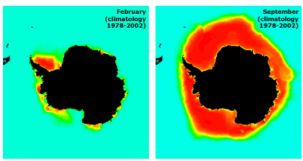
Affect of coastal flow – ice bunches up along the peninsula

Slide 18
Upwelling here is caused by the opposing winds and currents .. Look at the difference in wind patterns

Slide 19
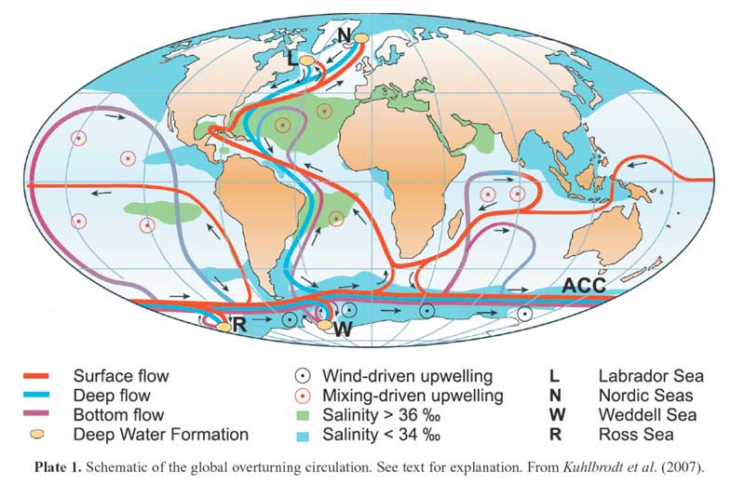

Slide 20
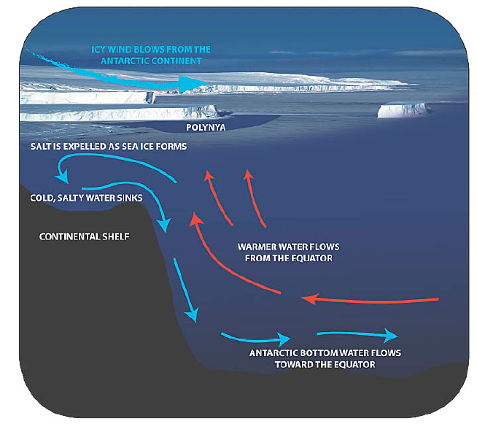
Upwelling of warm water!!!

Slide 22
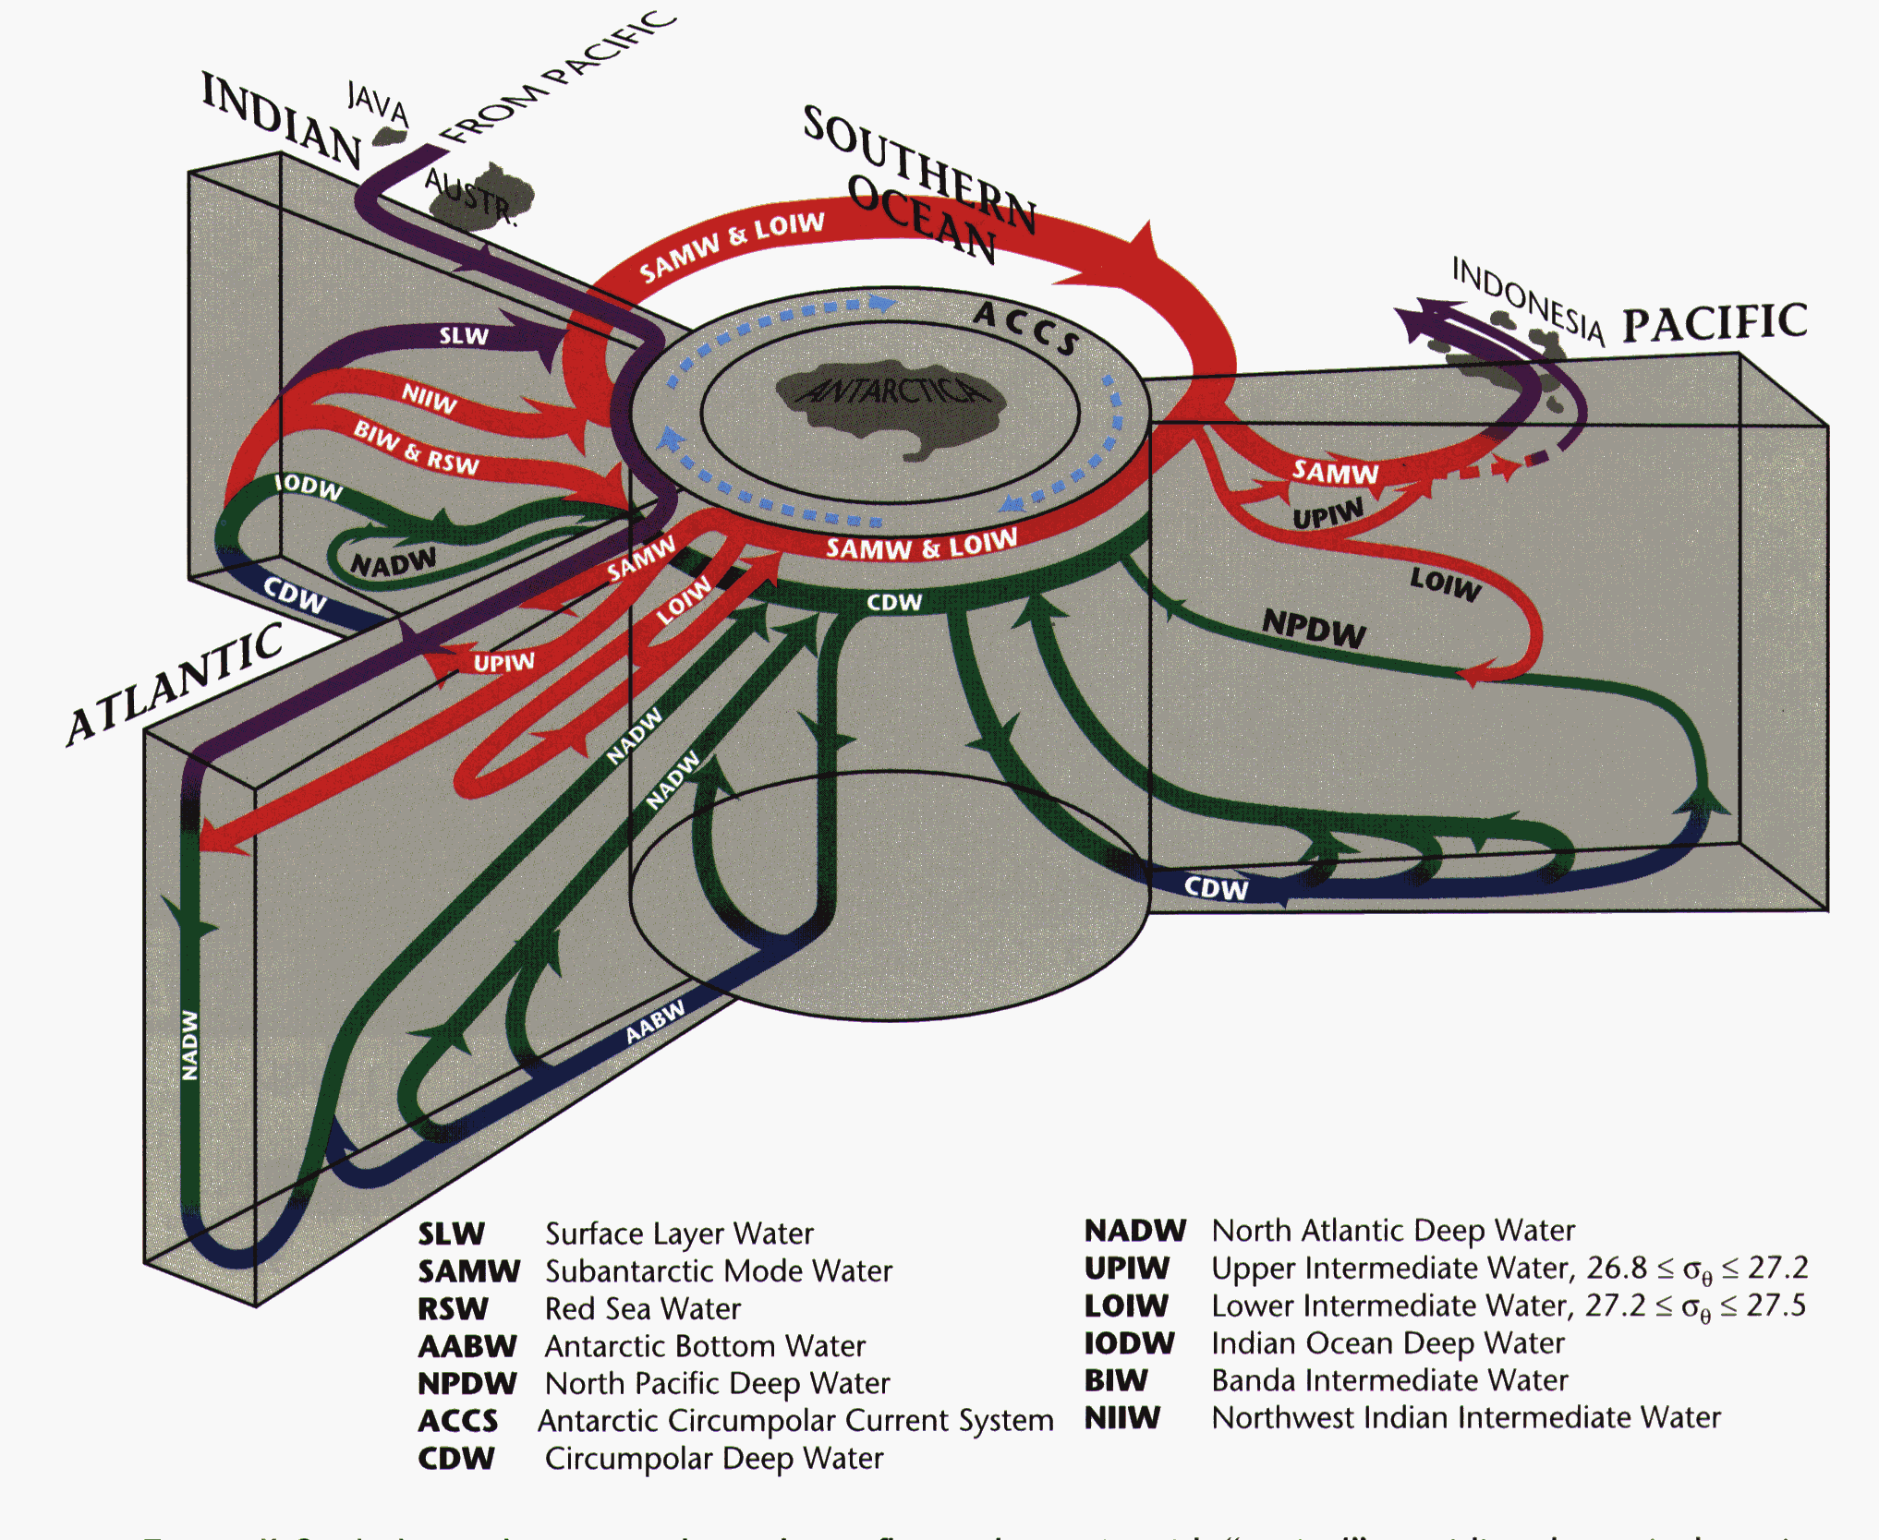

Slide 23
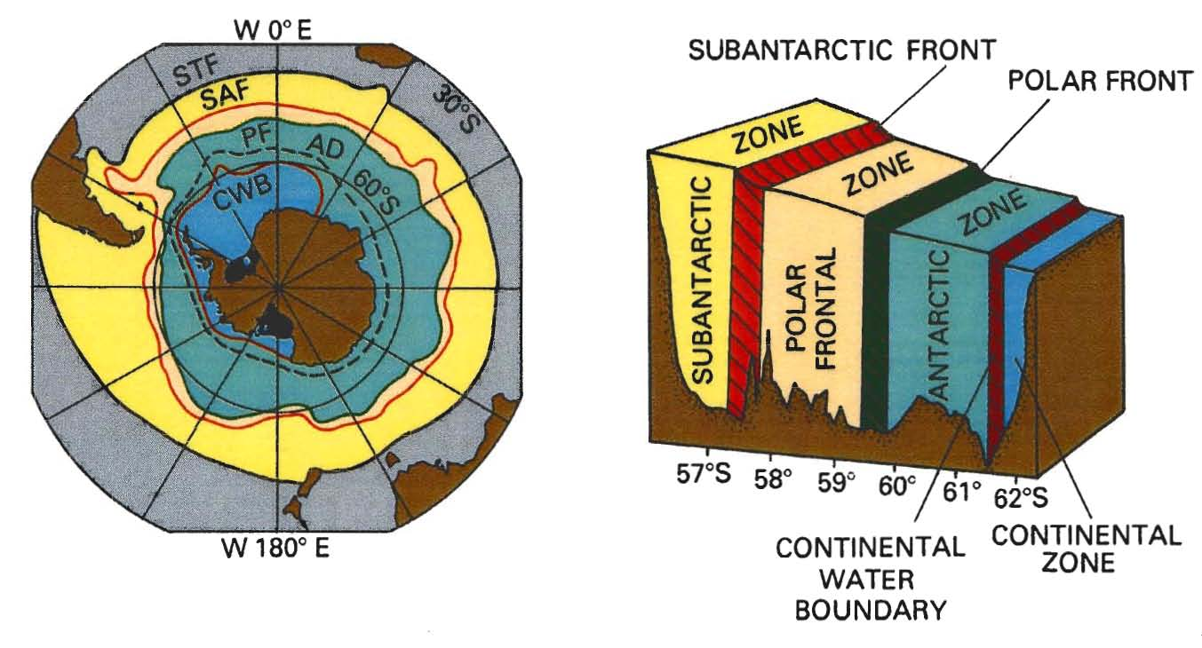
Fronts of the Antarctic Circumpolar Current
Tomczak and Godfrey, Ch. 6
Most transport is carried in the fronts
Subantarctic Front and Polar Front most important
Another important front: Southern ACC Front (not shown here)

Slide 24
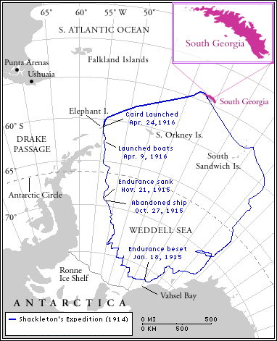
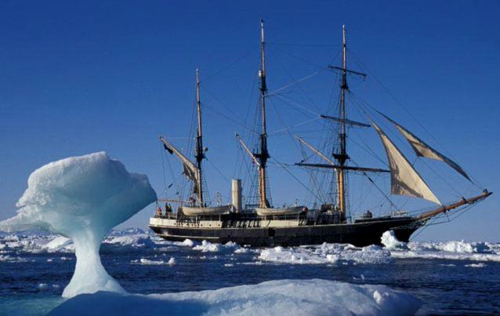
Story of Ernest Shackleton – using history to understand ocean circulation!
Aim to cross Antarctica..
..went badly wrong!
1914-1916!

Slide 25
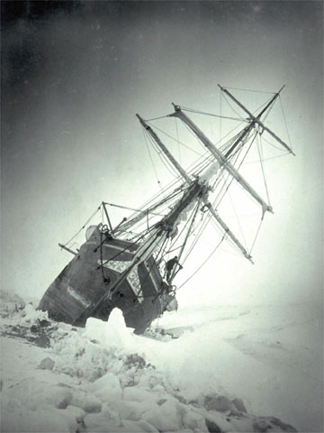
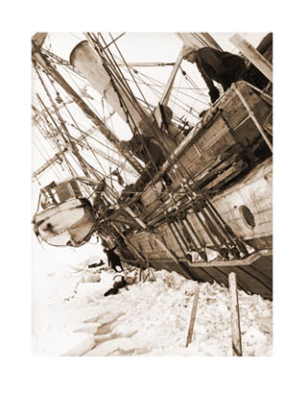
Endurance gets crushed in the ice

Slide 26
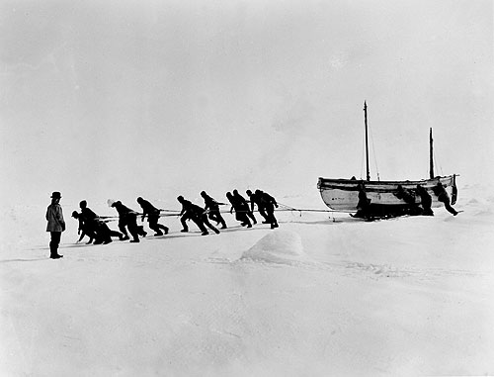
Attempt to save themselves – the crew walk out of the frozen wasteland pulling 3 lifeboats

Slide 27
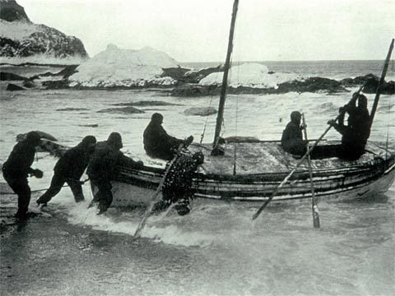
After arrival at Elephant island 6 sail to South Georgia

Slide 28

Left at Elephant island for 9 months!

Slide 29
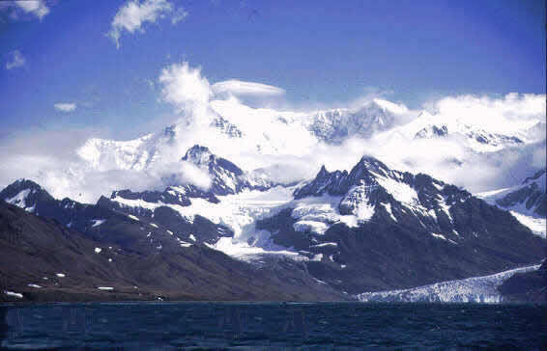
Imagine walking over this!

